Slide 1
WESTBRIDGE NEIGHBORHOOD POOL ANNUAL MEETING 2017

Slide 2
Board Members
Name | Title
Traci Vinopal-Phillips | President
Kraig Renken | Vice President
Ryan Meester | Treasurer
David James | Secretary
ALL POSITIONS ARE OPEN FOR NEW VOLUNTEERS

Slide 3
Pool Rules Update / Refresher
Guest Passes – Adult guests may stay at the pool without the member being present once they have been signed in.
There will also be a $20 day pass available for families who are new to the neighborhood or planning to move to the neighborhood and who wish to experience the pool first hand.
One Babysitter pass will be valid for both Grandparents
Swimmers must be Members or an invited guest of a member – Westbridge Residents cannot be your guest
Shower before entering the pool
Swimming diapers required by small children who are not toilet trained

Slide 4
Pool Rules Refresher (cont.)
No hanging on basketball rims or the volleyball net
Pool monitors have the final say
No food or drinks within 6’ of the pool
Chewing Gum is not allowed
No glass containers

Slide 5
Pool Rules Refresher (cont.)
No Smoking
Please clean up after yourself
Be aware of our neighbors and keep the noise at an acceptable level
Sign in with the monitor
Maximum of 6 guests

Slide 6
Annual Fees For 2017
 | Fees @ Opening | Fees if Joining After July 6th | Fees if Joining After August 16th
Family Membership | $400* | $300 | $150
Couples Membership | $300* | $200 | $75
First Babysitter | $25 | $25 | $25
Additional Babysitter | $5 | $5 | $5
* $50 Discount if paid by TODAY

Slide 7
2016 Summary
116 total Members
79 Westbridge Family Memberships
6 Westbridge Couple Memberships
30 Kilkenney Family Memberships
1 Kilkenney Couple Memberships
Profit of $526 with all members
Loss of over $10,000 w/o Kilkenney Memberships

Slide 8
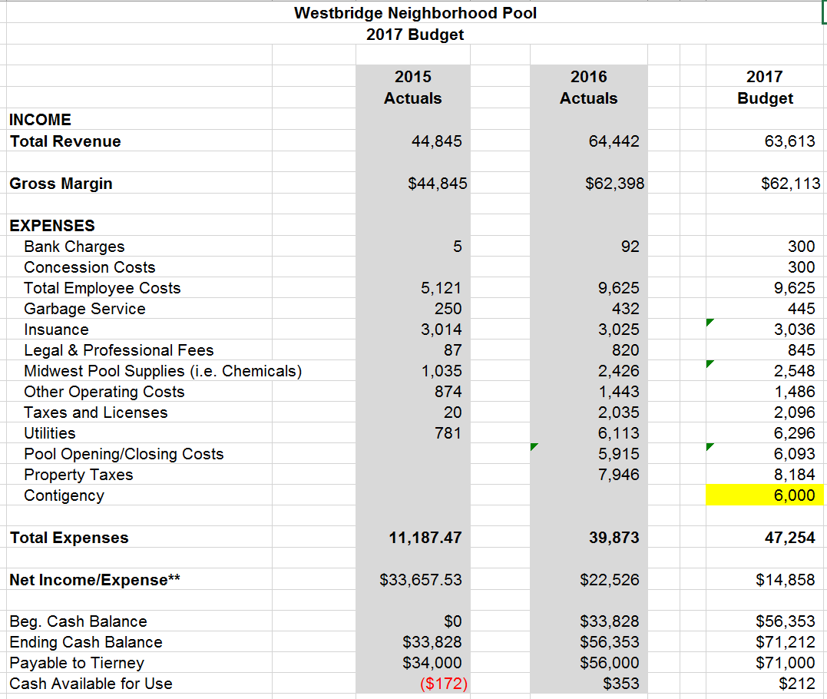
2017 Budget

Slide 9
Guest Passes
Annual Fee includes 1 Guest Pass (a punch card that allows a total of 10 guest entries)
Maximum number of guests per family on any one visit is 6
Additional Guest passes (10 entries) are available at $25 each – unused passes will be carried over to 2018 Passes maybe left with the Monitors for safe keeping if desired.

Slide 10
Babysitters
Are Responsible for the conduct and safety of children in their care
Are not allowed to sponsor guests
If a babysitter is at the pool without responsibility for children they are considered a guest and will need a guest pass
Need to complete the insurance indemnity form

Slide 11
Key Fobs
Will be re-activated for paid up members from the day the pool re-opens
Additional key fobs may be purchased for a $10 fee.

Slide 12
Web Site – www.westbridgepool.com
Where to find information on abnormal opening closings
Parties
Pool Rules
Membership Applications
Insurance Forms
Etc.

Slide 13
Questions???

